Slide 1
360° Product Photography
Senior Design
Fall 2018
Notes:
Brett

Slide 2
Company Background
Spreetail is an e-commerce company headquartered here in Lincoln.
Third-party partner that sells to marketplaces such as Amazon, Ebay, Walmart, etc.
In 2019, the company is relaunching their website.
Want to increase quality of customer experience.
Goal is creating content that sets themselves apart from competition.
This is where we come in: automating 360° photography of products.
Notes:
Brett

Slide 3
Team Organization
Team
Taher Ahmed (Product Manager & Lead)
Jared Nightingale (Dev. Manager)
Brett Middle
HaoZhou Li
Anthony Tran
Yang Xiao
Sponsors
Clayton Henderson
(Listing Optimization Squad Lead)
Taylor Kohl (Head of Product)
Notes:
Brett (everyone introduce themselves for team, Brett says sponsors)

Slide 4
Project Overview
Project Vision
Produce a software solution to invoke and control camera hardware to quickly and efficiently take high quality 360° photography of products.
Notes:
Jared

Slide 5
Project Overview
Project Objectives
Build a portable camera rig to take 360° photography
Develop a web server to interact with front end and camera rig
Develop a front-end to allow camera rig control
Notes:
Jared

Slide 6
Project Overview
Success Criteria
A User Can:
Select a hardware rig to control
Search item ID and take photos for an item
View preview image of product on turntable
Begin photo taking process
Select and delete photos to use
Choose to store photos in Spreetail Azure blob or retake photos
Notes:
Jared

Slide 7
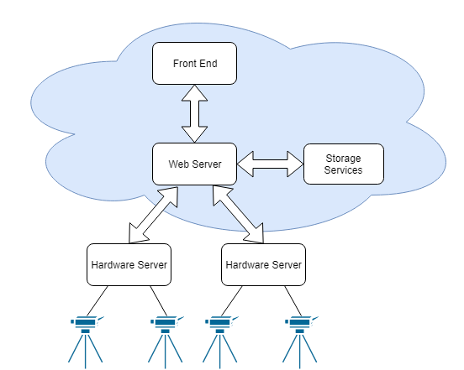
Architecture Diagram
Notes:
Jared

Slide 8
Accomplishments
Researched:
Existing 360 photography solutions
Camera control libraries (gphoto2)
Compatible cameras (DSLR vs webcam)
Tested DSLRs vs Webcams
Results concluded that we need to use DSLRs
Built a PVC Tripod prototype
Created front end Mockup
Notes:
Taher

Slide 9
Current Status/Progress
Biggest Risks/Issues
Spent too much time on hardware portion
Behind on software development, currently catching up
Entire team working on same tasks, slow development
Spent too much time on webcam vs DSLR testing
Notes:
Taher

Slide 10
Current Status/Progress
Major Roadblocks We’ve Overcome
Lack of detailed story mapping
Spent an entire team time mapping out project
Entire team working on same portion of project
Split dev team into three 2-person teams
Each team focuses on a section of the project
Learning and developing in new languages and technologies
Notes:
Taher

Slide 11
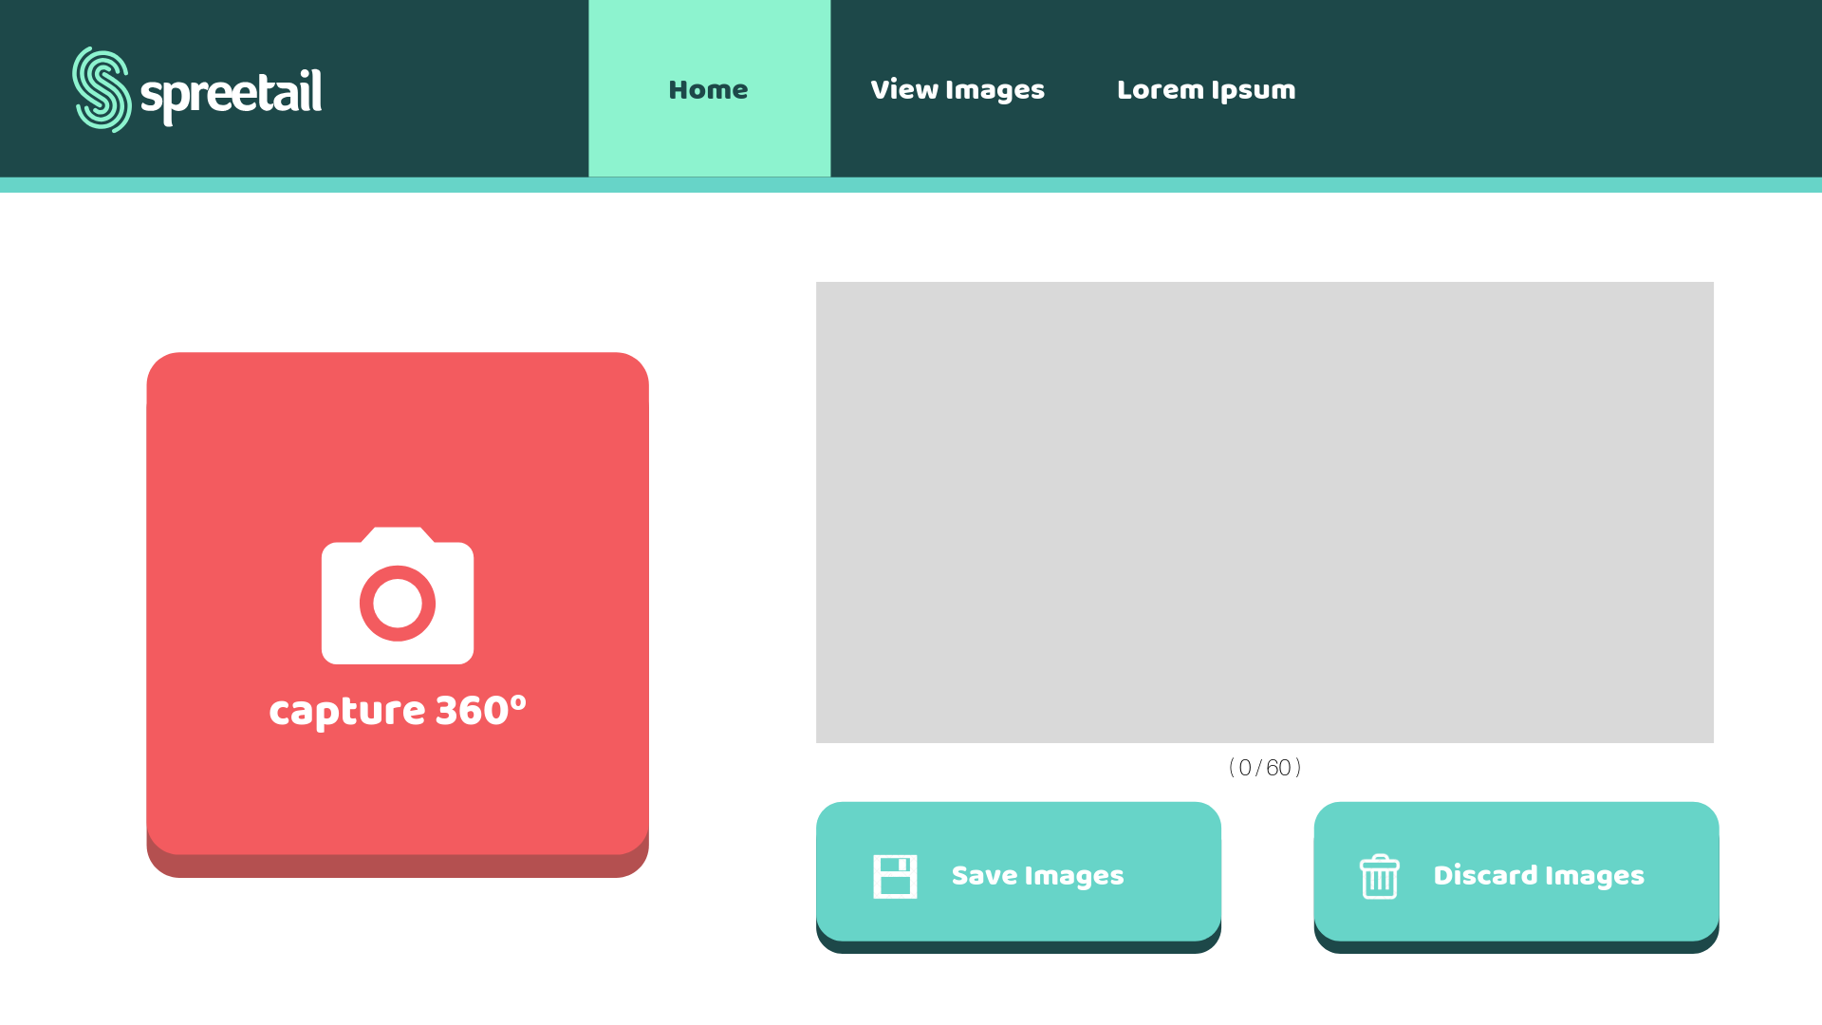
Demo of Current Progress
Site mockup
Notes:
Anthony

Slide 12
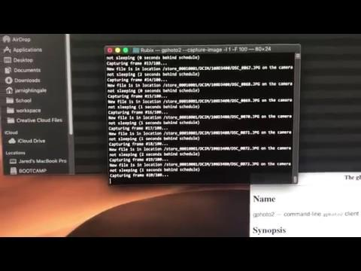
Demo of Current Progress
DSLR with turntable
Notes:
Anthony

Slide 13
List of Development Practices
Use Zenhub for story tracking
Agile Development
Stand up each team time
Weekly Stakeholder meeting
2 week sprints
End of sprint - sprint planning and retrospective of previous sprint
Notes:
Anthony

Slide 14
Security and Privacy Risks + Steps to avoid risks
Main risk - Web server security
Spreetail offered security module for authentication
Developed in .NET Web API
Communication between hardware servers and web server is on local network
Personal Security
Developing only on Spreetail-given PCs
Using Spreetail-given email address for project communication
Notes:
Li

Slide 15
Approaches To Promote More Effective Communication
Between Team Members
Slack is used outside of team times
Broken up into three 2-person teams, easier to involve everyone
Stand-ups are held at the beginning of team times to monitor progress
Between Team and Sponsor
Meet weekly with sponsor during team times at Spreetail
Weekly online stand-ups
Communicate through Slack for any inquiry
Notes:
Li

Slide 16
Ethical Issues Related to Project
Use of online content/resources
Using gphoto2 which is under the GNU lesser General Public License, free software as a our photo control library
Impacts of the system on society
Will our project help users of the Spreetail site?
Notes:
Yang

Slide 17
Lessons Learned
Gphoto2 is a very useful library for camera control
DSLR quality is hard to match
Detailed story mapping makes for easy development tracking
Splitting team up into sub-teams is helpful for project progress
Time-management is a must with defined team times
Notes:
Yang

Slide 18
Next Semester Success Plans
Focus on behaviors
Unit tests are a must
Always have a current build
Maintain story map and update regularly
Continue sponsor communication
Ask for help when needed
Keep all parties updated on progress
Notes:
Yang

Slide 19
Questions?

